Slide 1
GOsC Patient Partner Programme
Q&A Webinar
Monday, 3 March 2025

Slide 2
Welcome
Welcome and introduce yourselves
Objectives for webinar
Your chance to us ask questions

Slide 3
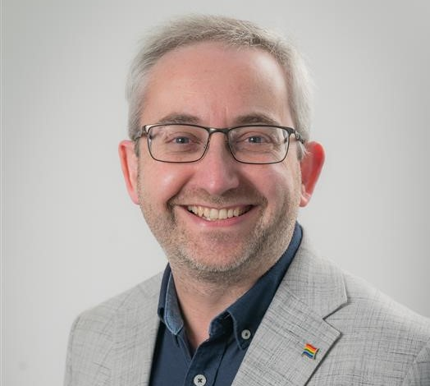
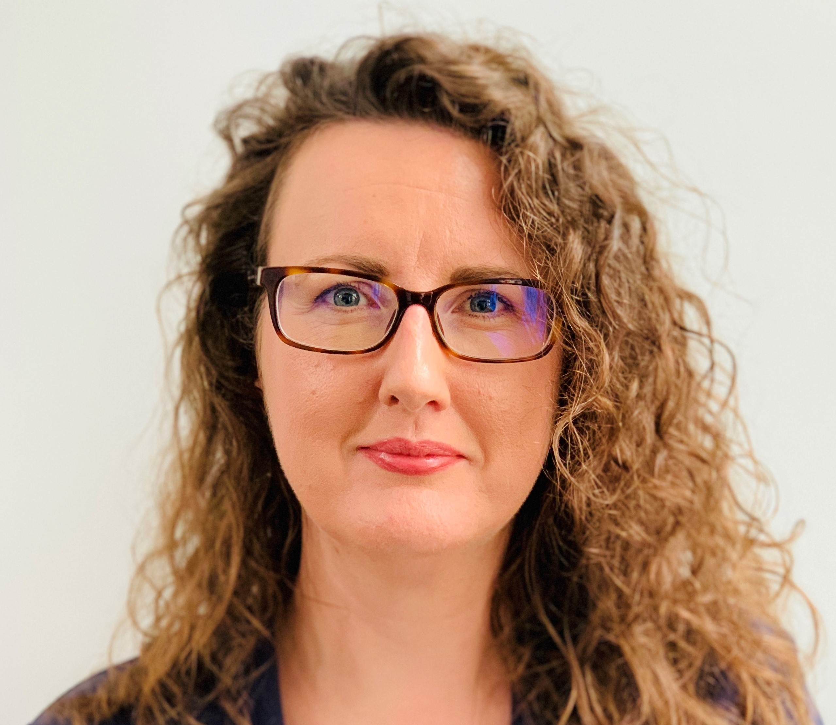
Introduction
Matthew Redford Chief Executive and Registrar | Rachel Heatley Senior Research and Policy Officer

Slide 4
A few things to note
The webinar will be recorded
You can submit your questions via the ‘Questions’ section of the control panel
All attendee mics are muted, and cameras are off
If we can’t answer every question tonight, we will follow up with you via email

Slide 5
Recruitment schedule
Closing date for applications
11:30am Thursday
13 March 2025
Interviews
Wednesday 4 June 2025
Appointment starts
1 September 2025

Slide 6
Webinar objectives
Offer an insight into the work of GOsC’s Council
01
Inform you about the Patient Partners Programme
02
Answer your questions
03

Slide 7
GOsC’s core functions
Setting and promoting high standards of osteopathic practice and conduct
Registering qualified professionals and ensuring their continuing fitness to practise
Assuring the quality of osteopathic education and training
Dealing with complaints through fitness to practise procedures

Slide 8
Our strategic priorities
Strengthening trust
01
Championing inclusivity
02
Embracing innovation
03

Slide 9
GOsC’s values
Collaborative
Influential
Respectful
Evidence-informed

Slide 10

Patient engagement at GOsC
Set up Patient Involvement Forum in 2021
34 members with diverse backgrounds
Workshops, focus groups, consultations, surveys
Projects: fitness to practise guidance, policy development, osteopathic education

Slide 11
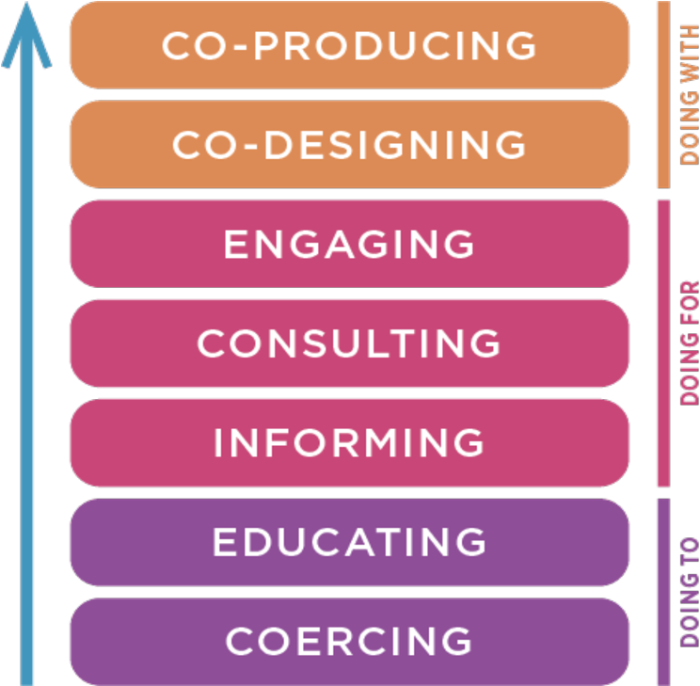
Patient Partners Programme
One-year pilot with possible extension
Strategic focus
Contribute to public and public protection
Represent the patient voice not a healthcare condition
No voting rights

Slide 12
Rationale for the programme
Enhance our strategies and decision making by incorporating insight from Patient Partners
Identify and address knowledge gaps and expectations of osteopathic patients
Promote among the profession an enhanced appreciation of patient-centred care
Proactively increase the diversity of GOsC

Slide 13
Criteria for the role
Essential
Desirable
  Firsthand experience of being an osteopathic patient
  Voluntary or paid experience in patient and/or service user-led groups in the healthcare sector
Non-executive or similar board experience in the healthcare sector
Passionate about patient engagement and public and patient protection

Slide 14
Role of the Council
Responsible for ensuring that the GOsC fulfils its statutory objectives
Sets the strategic direction for the organisation and oversees the implementation of that strategy

Slide 15

A typical Council meeting
  Preparation for a meeting
  Duration and outline of meetings
  What is expected of me when I attend Council?
  How many meetings are there?

Slide 16
Support for Patient Partners
Mentoring, buddy system and continuous support
Networking
Development days

Slide 17
Upcoming Council activities
2025 | Activity
Wed 17 September | Council Strategy Day
Wed 22 October | Policy and Education Committee meeting
Wed 19 November | First Council meeting
2026
Wed 11 February | Council engagement event
Thurs 12 February | Council meeting
Notes:
In-person meetings
Induction activities will be scheduled with successful candidates and their availability

Slide 18
Things to consider
The role's purpose: Do you understand what's involved and why it matters?
The governance structure: Have you explored how health regulator’s (and in particular GOsC) function?
Your own needs: What training or support would help you succeed?

Slide 19
Application form: STAR model
SITUATION: Describe the situation when you carried out the relevant activities that demonstrate the competency.
TASK: Clarify the task you needed to undertake to meet the objectives
ACTION: What actions did you take? Focus on your skills, decisions and behaviours.
RESULT: What was the outcome of your actions? Why was the outcome successful?

Slide 20
Example: Member of GP Practice patient group
SITUATION: Help to address concerns about accessibility and quality of care in GP surgery
TASK: Facilitate discussions on improving patient experiences while ensuring the practice met regulatory and professional guidelines.
ACTION: Gathered patient feedback which highlighted areas where clearer communication and adherence to best practices were needed.
RESULT: Transparent complaints procedures implemented, and patients reported greater confidence in the care they received
Notes:
Understanding of Public and Patient Protection competency
Example: Through my voluntary experience in a patient group within a GP practice, I gained firsthand insight into the importance of patient-centered care and regulatory oversight. (Situation) In this role, I worked alongside healthcare professionals and patients to address concerns about accessibility and quality of care. (Task) One key responsibility was to help facilitate discussions on improving patient experiences while ensuring the practice met regulatory and professional guidelines.(Action) I contributed by gathering patient feedback, highlighting areas where clearer communication and adherence to best practices were needed. I also helped advocate for transparent complaints procedures, ensuring that patients understood how to raise concerns confidently. (Result) This experience reinforced my understanding of how effective regulation protects both patients and professionals, promoting trust, accountability, and continuous improvement in care standards.

Slide 21
Something else to consider
Who are you?
What are your values?
What sparks your interest?

Slide 22
Why apply?
Incredible opportunity for both personal and professional growth
Contribute to the future of osteopathic regulation
Gain a deeper understanding of healthcare governance

Slide 23
Gaining further insight
If you are interested in gaining more of an insight into our work, you can attend a Policy and Education Committee meeting online or in-person on Thursday 6 March: 10am-4pm
You can also view previous Council meeting papers and minutes on our website
https://www.osteopathy.org.uk/about-us/the-organisation/meetings/council-past-papers/

Slide 24
Q&A
Your chance to us ask questions
Notes:
Questions for Patient Partners webinar
Q: Why is experience of osteopathic treatment essential?
Most osteopaths work in private practice and in small clinics – even those in group practice often share a treatment room at different times.
Whereas other health professionals such as nurses, physios and doctors mostly work in the NHS. So, employers, teams and system regulators all play a part in reducing the risk of harm and motivating and encouraging behaviour in accordance with standards. So, the regulation landscape differs between osteopaths and other health professionals. Having direct experience of osteopathic treatment will help candidates better understand the specific context osteopaths work in.
Direct experience with treatment also gives insight into how osteopaths apply their skills, communicate with patients, and maintain professional conduct. Familiarity with treatment can help Patient Partners engage more effectively in governance discussions about education, practice guidelines, and regulatory policies.
Q: What is the length of the appointment?
A: The term is for one year. However as this is a pilot, there is a possibility of reappointment for a further one-term year term based on a successful candidate’s desire to continue, their performance and council needs. Review after 6 months to see how things are going and then an evaluation of the programme towards the end of the year.
Q: Do I need prior governance experience?
A: While prior experience is beneficial, it is not essential. Strong strategic thinking, leadership, and decision-making skills are highly valued.
Q: What does the role entail?
A: Critically reviewing papers that are written by GOsC staff to ensure we are meeting our statutory duty protect the health, safety and wellbeing of the public, and to protect the reputation of the osteopathic profession.
Perhaps asking has GOsC done enough to consult with patients? If they have done enough could they do it better? Perhaps you’ve been involved in a patient group that trialled an innovative way to gather patient feedback that we haven’t heard about and this is something we consider trialling in the future. That would tie in with our strategic priority embracing innovation.
Q: One of the application forms ask questions about my personal details how will this be used in the application process?
This information is collected to produce information about the diversity of the field of applicants. It may be published in aggregated form to meet our public sector equality duties in legislation. However, the panel don’t see the responses to this form and all applications are anonymised so there is no unconscious bias.
Q: Why is there such long gap between applying and start date?
The number of applicants, hiring criteria, number of interviews, HR processes, and unforeseen circumstances and delays can all play a role. As we are recruiting for 2 positions we are anticipating a higher number of applications than usual. If we receive more than 20 applications we will have an external organisation do our long listing for us.

